Slide 1









Home Assistant Shopping list
Barcode Scanner
Serial TTL
ESP8266
Home Assistant
TTS
Voice Assistant
Thermal Printer
Serial TTL
HA Client
Mobile Phone
ESPHOME
API
Display
I2C
HA Client
Touchscreen
Buttons
TTL

Slide 2
MEALIE Shopping list
Barcode Scanner
Serial TTL
ESP8266
Home Assistant
TTS
Voice Assistant
Thermal Printer
Serial TTL
HA Client
Mobile Phone
ESPHOME
API
Display
I2C
HA Client
Touchscreen
Buttons
TTL
Mealie
Integration
Mealie

Slide 3
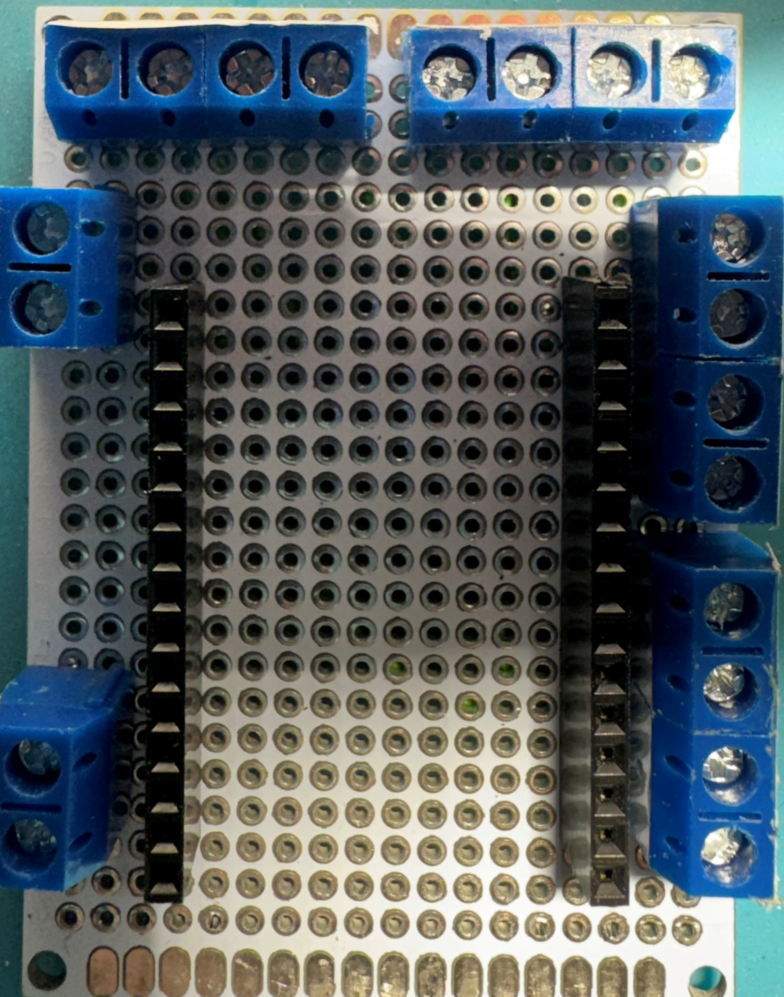
Button Left
Button Right
SW
LED
SW
GM60
Gnd
GPIO01
Gnd
GPIO00
Gnd
GPIO03
Gnd
GPIO16
Buzzer
GPIO14
GPIO04
I2C Display
sda
Gnd
GPIO05
scl
3v3
Gnd
Power
GPIO13
Scanner
Rx
GPIO15
Tx
Gnd
Gnd
5V
3v3

Slide 4
GM60
 | TOUT |  |  |  |  | GPIO16 | BUTTON – LED - ROOD
LEDs & BUTTONS - GND | GND |  |  |  |  | GPIO05 | DISPLAY – SCL – GROEN
 | Vout USB |  |  |  |  | GPIO04 | DISPLAY – SDA – BLAUW
 | GPIO10 | ESP8266 |  |  |  | GPIO00 | BUTTON – LED - ROOD
 | GPIO09 |  |  |  |  | GPIO02
 | GPIO08 |  |  |  |  | 3v3 | DISPLAY – 3V3 –ROOD
 | GPIO11 |  |  |  |  | GND | DISPLAY – GND – ZWART
 | GPIO07 |  |  |  |  | GPIO14 | BEEPER – ROOD
 | GPIO06 |  |  |  |  | GPIO12
ZWART – BEEPER | GND |  |  |  |  | GPIO13 | SCANNER – RX - GEEL
 | 3v3 |  |  |  |  | GPIO15 | SCANNER – TX - GROEN
 | EN |  |  |  |  | GPIO03 | BUTTON – SWITCH – GROEN
 | RST |  |  |  |  | GPIO01 | BUTTON – SWITCH – GROEN
VOEDING – GND | GND |  |  |  |  | GND | SCANNER – ZWART
VOEDING – 5v | Vin |  | USB |  |  | 3v3 | SCANNER – ROOD

Slide 5
GM67
 | TOUT |  |  |  |  | GPIO16
SCANNER – GND – GROEN | GND |  |  |  |  | GPIO05 | DISPLAY – SCL – BLAUW
SCANNER – 5V – ROOD | Vout USB |  |  |  |  | GPIO04 | DISPLAY – SDA – GROEN
Flash Data 3 pin | GPIO10 | ESP8266 |  |  |  | GPIO00 | BUTTON – SWITCH - GROEN
Flash Data 2 pin | GPIO09 |  |  |  |  | GPIO02 | BUTTON – SWITCH – GROEN
Flash Data 1 pin | GPIO08 |  |  |  |  | 3v3
Flash CMD | GPIO11 |  |  |  |  | GND | PRINTER – GND – ZWART
Flash Data 0 pin | GPIO07 |  |  |  |  | GPIO14 | PRINTER – RX – GROEN
Flash CLK | GPIO06 |  |  |  |  | GPIO12 | PRINTER - TX – GEEL
Common LED’s / Buttons | GND |  |  |  |  | GPIO13 | BUTTON – LED - ROOD
 | 3v3 |  |  |  |  | GPIO15 | BUTTON – LED - ROOD
 | EN |  |  |  |  | GPIO03 | SCANNER – TX – ZWART
 | RST |  |  |  |  | GPIO01 | SCANNER – RX – GEEL
VOEDING – GND | GND |  |  |  |  | GND | DISPLAY – GND – ZWART
VOEDING – 5v | Vin |  | USB |  |  | 3v3 | DISPLAY – 3v3 - ROOD

